Slide 1
Mapping Outsourced Labs to CAE KU’s and NICE KSA’s
Chris Simpson,
Director National University Center for Cybersecurity

Slide 2
Agenda
Purpose
Background
National University’s journey to outsourced labs
Challenges of using outsourced labs
Building a method to share lab information

Slide 3
About National University
Among the largest private, nonprofit universities in California, dedicated to serving a diverse student population such as working parents, educators and members of our armed forces.
Accelerated format
One month class
Students take one class at a time
Each class is 4.5 quarter hours
Same amount of material as in a regular quarter length course
Online/Onsite/Hybrid
Onsite meets twice a a week 5:30pm-10pm plus one Saturday
Cohort model

Slide 4
Goal
Build a framework and tool to easily map labs to CAE Knowledge Units and NICE KSA’s and:
Allows for easy reporting of requirements
Allows for easy discovery of relevant labs for schools in search of labs

Slide 5
Background
Hands on labs are a critical component of any cybersecurity program and a CAE requirement
Several ways to deliver lab content
Develop and deploy labs on internal or outsourced infrastructure
Utilize labs from external lab providers
Utilize free grant resourced labs
Use free and open source labs

Slide 6
Background
Many externally provided labs aren’t mapped to CAE Knowledge Units or the NICE Framework, especially the open source labs.
This makes it challenging for schools to identify the right labs for their program and requires extensive efforts to map the labs to meet these different requirements.
There is duplicated effort as different institutions map the same labs and in many cases will map them to the same knowledge units and NICE KSA’s.

Slide 7
National University’s Lab Journey
MS Cybersecurity Program started 2011
Created Virtual Lab Environment (VEL)
Outside contractor
Surplus hardware
VMWARE environment
Migration to lab managed by IT Department
Information Security Lab Environment

Slide 8
Challenges of Running an Internal Lab
Help Desk
Academic vs Technical issues
Hours of operation
Student complete school work in the evening and on weekends
”Ticket Management”
Admin access to systems
Developing lab content
Cost

Slide 9
Finding Outsourced Labs
“Word of Mouth”
Textbook Vendors
Vendor booths
Google

Slide 10
Picking the right labs
Most vendors don’t map to KU/KSA’s
Some selection criteria
Quality of labs
Ease of access (LMS integration)
Cost
Security
Lab Types
Directive vs Non Directive
Scenario vs Non Scenario

Slide 11
Providers
Not an official endorsement from National University

Slide 12
Providers
Current
Researching
Circadence (Paid)
Immersive Labs (Free)
Infosec Learning (Paid)
ITPro.tv (Paid)
Jones & Bartlett (Paid)
NICE Challenge (Free)
Over the Wire (Free)
PicoCTF (Free)
Hack The Box (Freemium)
Linux Academy (Paid)
AttackDefense.com (Paid)

Slide 13
Challenges of Outsourced Labs
Downtime
Support
Updates
Cost
No single vendor provides everything you need
Publicly available answers

Slide 14
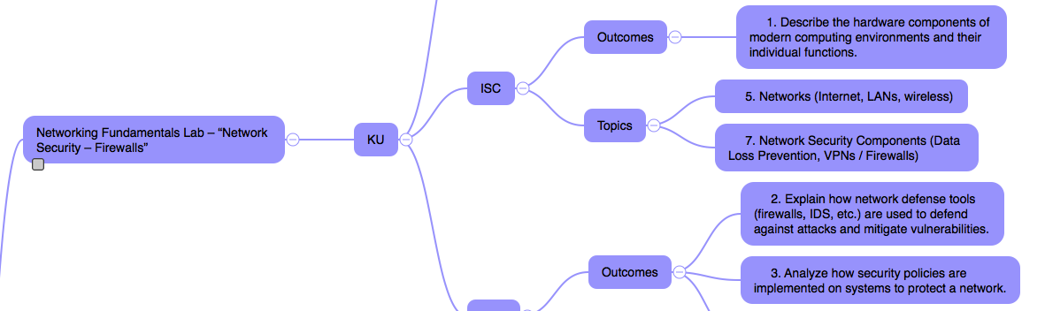
How we mapped labs to KU/KSA’s
Manually reviewed lab content
Mapped to knowledge unit
Used CyberEd wiki to crosswalk to KSA
Subjective

Slide 15
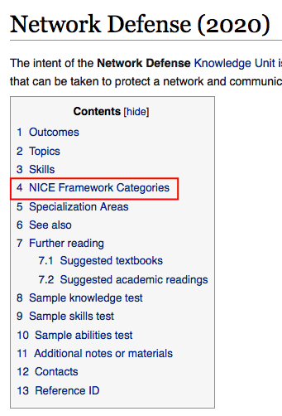
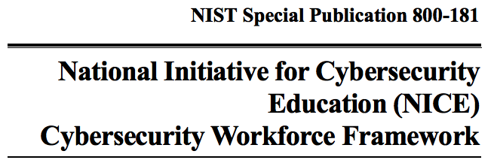
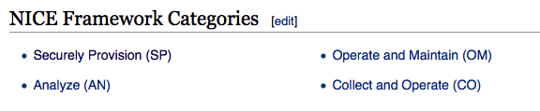
KU NICE Crosswalk

Slide 16
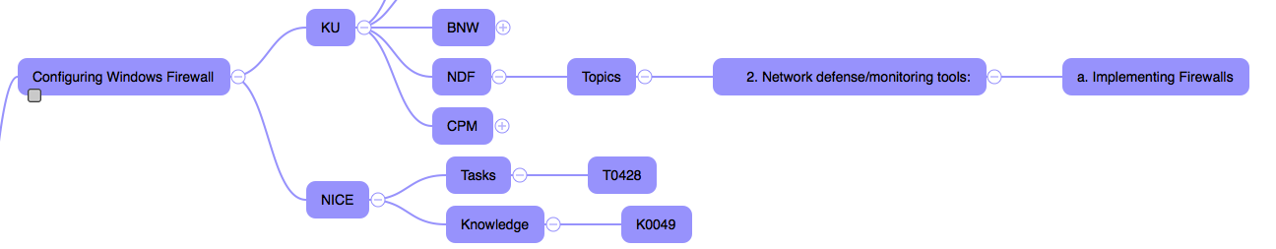
KU NICE Crosswalk

Slide 17


Collecting and storing mappings
iThoughts
Export from mind map to csv file
Import to Excel
Clean up columns

Slide 18
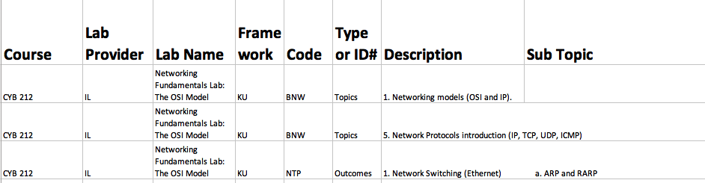
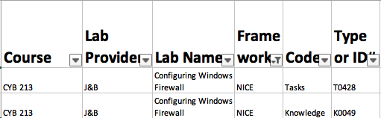
Example

Slide 19
How to manage and share information?
Build web based database with lab and mappings
How to get there?
Initial ideas
Spreadsheet/CSV
Mind Maps
Share via github

Slide 20
Where to find mappings
https://github.com/NU-Cybersecurity/labmapping
Spreadsheets and mind maps

Slide 21

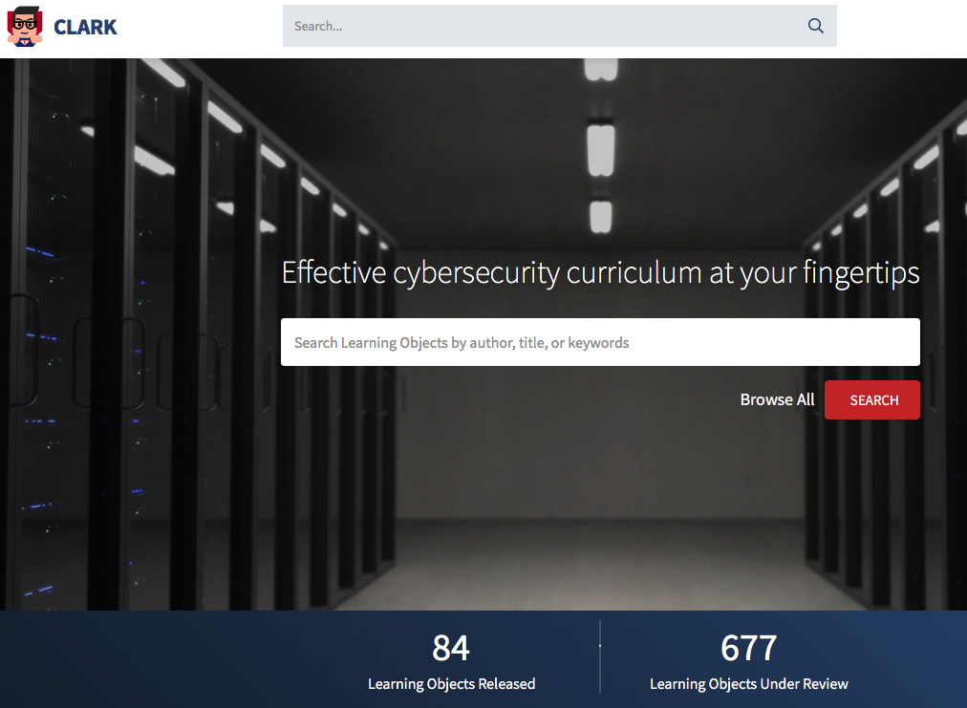
New Discovery
http://nccp.clark.center
http://clark.center

Slide 22
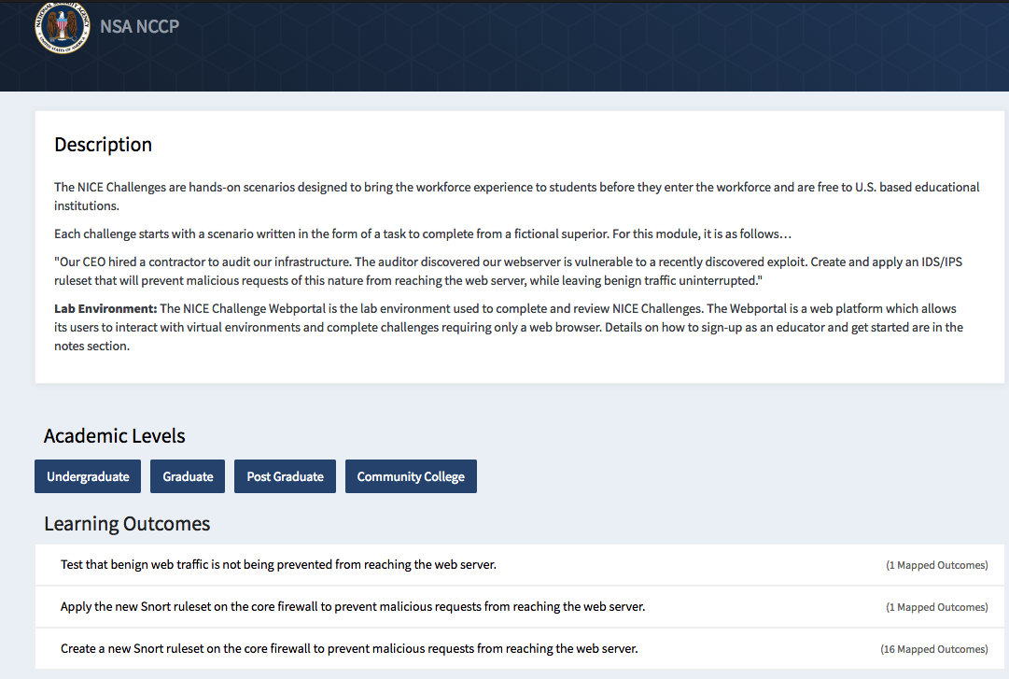

Slide 23
Way Ahead
Leverage tools like Clark and Github to crowdsource lab information
Leverage CAE buying power

Slide 24
Questions?
Email: csimpson@nu.edu

